Slide 1

IT-4259: Computer Network Security
for
4th Year 2nd Semester of B.Sc (Honors) in IT (5th Batch)
Lecture: 01
Mathematics for Network Security
Prepared by:
K M Akkas Ali
akkas_khan@yahoo.com, akkas@juniv.edu
Associate Professor
Institute of Information Technology (IIT)
Jahangirnagar University, Dhaka-1342

Slide 2
Lecture-01: Mathematics Network for Security
Objectives of this Lecture:
  To review integer arithmetic, concentrating on divisibility.
  To find the greatest common divisor using the Euclidean algorithm.
  To understand how the extended Euclidean algorithm can be used to solve linear Diophantine equations.
  To determine the multiplicative & additive inverse of an integer.
  To emphasize the importance of modular arithmetic and the modulo operator, because they are extensively used in cryptography.
  To review matrices and to determine the multiplicative inverse of a matrix.

Slide 3
Books Recommended
Cryptography & Network Security
- Behrouz A Forouzan
Cryptography & Network Security
- William Stallings

Slide 4
Why Need Mathematics in Cryptography?
  Modern cryptography is heavily based on some areas of mathematics, including number theory, linear algebra, and algebraic structures.
  Cryptographic algorithms are designed around computational hardness assumptions using mathematical functions and formula, making such algorithms hard to break in practice by any adversary.
  A list of mathematical fields used in cryptography is given below.
  Number theory:
  It is used to understand why and how RSA works. Some algorithms use number theory for the difficulty of factoring large numbers as their basis.
  Group theory:
  Group theory is used to understand why and how El Gamal works.
  Probability theory:
  It is used in analyzing many kinds of ciphers to better understand what "statistical security" means.
  Algebraic structure:
  The theory of finite fields is used in multiparty computation.
  Linear Algebra:
  Lagrange interpolation is used in Shamir's Secret Sharing Scheme. Some linear operations are also used in AES.

Slide 5

Integer Arithmetic: The Set of Integers
In integer arithmetic, we use a set and a few operations.
We are already familiar with this set and the corresponding operations, but they are reviewed here to create a background for modular arithmetic.
The set of integers, denoted by Z, contains all integral numbers (with no fraction) from negative infinity to positive infinity.
Figure below shows the set of integers.
Figure: The set of all integers

Slide 6
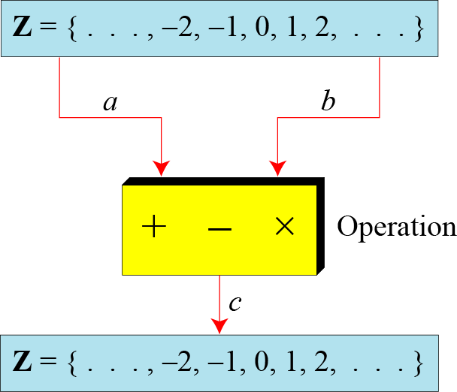
Binary Operations
A binary operation takes two inputs (e.g. a and b) and creates one output (e.g. c).
In cryptography, we are interested in three binary operations applied to the set of integers: addition, subtraction and multiplication.
Figure: Three binary operations for the set of integers

Slide 7
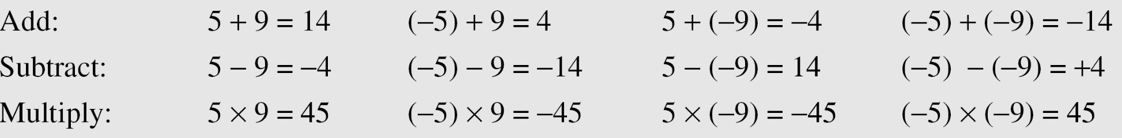
Binary Operations
The following examples shows the results of the three binary operations on two integers.
Because each input can be either positive or negative, we can have four cases for each operation.

Slide 8
Integer Division
In integer arithmetic, if we divide a by n, we can get q and r. The relationship between these four integers can be shown as
a = q × n + r
Where,
a → dividend
n → divisor
q → quotient
r → remainder
Note:
Division is not a binary operation, because it produces two output instead of one (q and r). Instead, we can call it division relation.

Slide 9
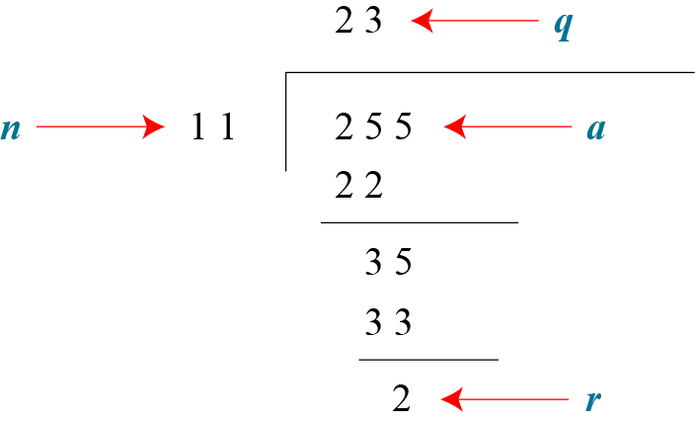
Integer Division
Example:
Assume that a = 255 and n = 11. We can find q = 23 and r = 2 using the division algorithm.
Figure: Finding the quotient and the remainder

Slide 10
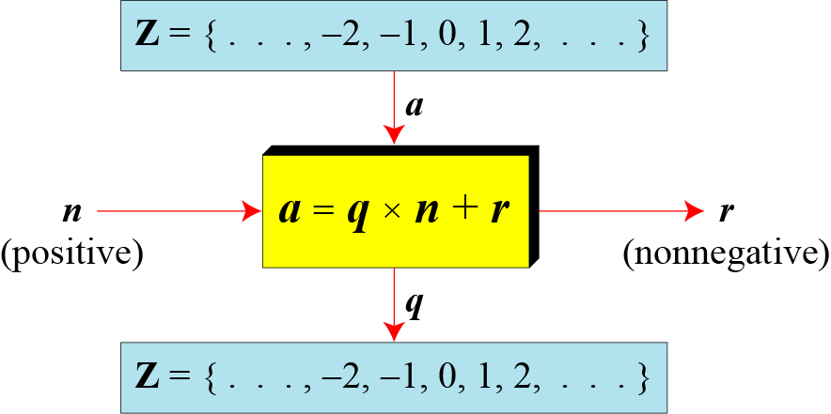
Integer Division
When we use the above division relationship in cryptography, we impose two restrictions:
The divisor be a positive integer (i.e. n>0)
The remainder be a non-negative integer (i.e. r>=0)
Figure: Division algorithm for integers

Slide 11
Integer Division
Example:
When we use a computer or a calculator, r and q are negative when a is negative.
How can we apply the restriction that r needs to be positive?
The solution is simple, we decrement the value of q by 1 and we add the value of n to r to make it positive.
n
r
r = n + r
q
q = q-1

Slide 12

Divisibility
Division relation is:
a = q × n + r
Where
a → dividend
n → divisor
q → quotient
r → remainder
If a is not zero and we let r = 0 in the division relation, we get:
a = q × n
We then say that
n divides a
or, n is a divisor of a
or, a is divisible by n
Therefore, when a is divisible by n and we are not interested in the value of q, we can write the above relation as a|n
If a is not divisible by n (i.e. if r is not zero), then we can write the above relation as

Slide 13


Divisibility
Example :
The integer 4 divides the integer 32 because 32 = 8 × 4. We show this as
b. The number 8 does not divide the number 42 because
42 = 5 × 8 + 2. There is a remainder, the number 2, in the equation. We show this as
Example:

Slide 14
Properties of Divisibility
Property 1: if a|1, then a = ±1.
Property 2: if a|b and b|a, then a = ±b.
Property 3: if a|b and b|c, then a|c.
Example:
Since 3|15 and 15|45, then according to this property, 3|45
Property 4: if a|b and a|c, then
a|(m × b + n × c), where m
and n are arbitrary integers
Example:
Since 3|15 and 3|9, then according to this property, 3|(15x2+9x4), which means 3|66

Slide 15
GCD: Greatest Common Divisor
A positive integer can have more than one divisor. For example, the integer 32 has six divisors: 1, 2, 4, 8, 16, 32.
We can mention two interesting facts about divisors of positive integers:
Fact 1:
The integer 1 has only one divisor, itself.
Fact 2:
Any positive integer has at least two divisors, 1 and itself (but it can have more).
The greatest common divisor (GCD) of two positive integers is the largest integer that can divide both integers.
GCD is often needed in cryptography.
Two positive integers may have many common divisors, but only one is the greatest of them.
For example, the common divisors of 12 and 140 are: 1, 2, and 4. However, the greatest common divisor is 4.

Slide 16
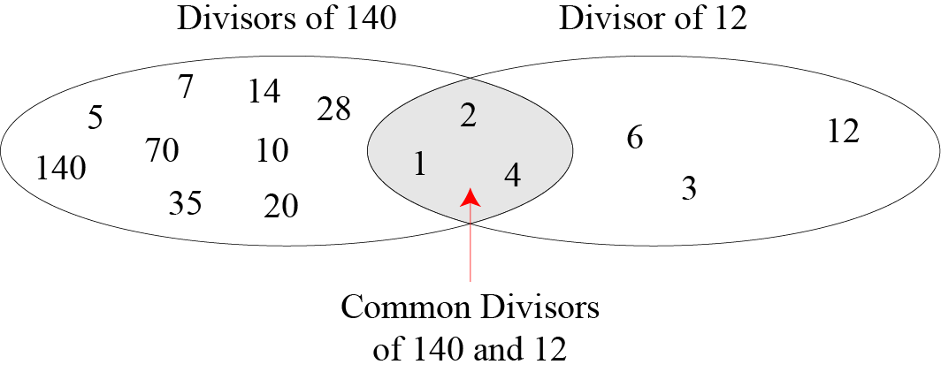
GCD: Greatest Common Divisor
Figure: Common divisors of two integers

Slide 17
GCD Using Euclidean Algorithm
Finding the GCD of two positive integers by listing all common divisors is not practical when the two integers are large.
More than 2000 years ago, a mathematician named Euclid developed an algorithm that can find the GCD of two large positive integers.
The Euclidian algorithm is based on the two facts:
Fact 1: When 2nd integer is zero, then gcd (a, 0) = a
Example: gcd(5, 0) = 5
Fact 2: When both integer is positive, then gcd (a, b) = gcd (b, r), where r is the remainder of dividing a by b (here the value of first and second integer is changed until the second integer becomes zero.
Example:
Gcd(36, 10) = gcd(10, 6) = gcd(6, 4) = gcd(4,2) = gcd(2, 0) = 2

Slide 18
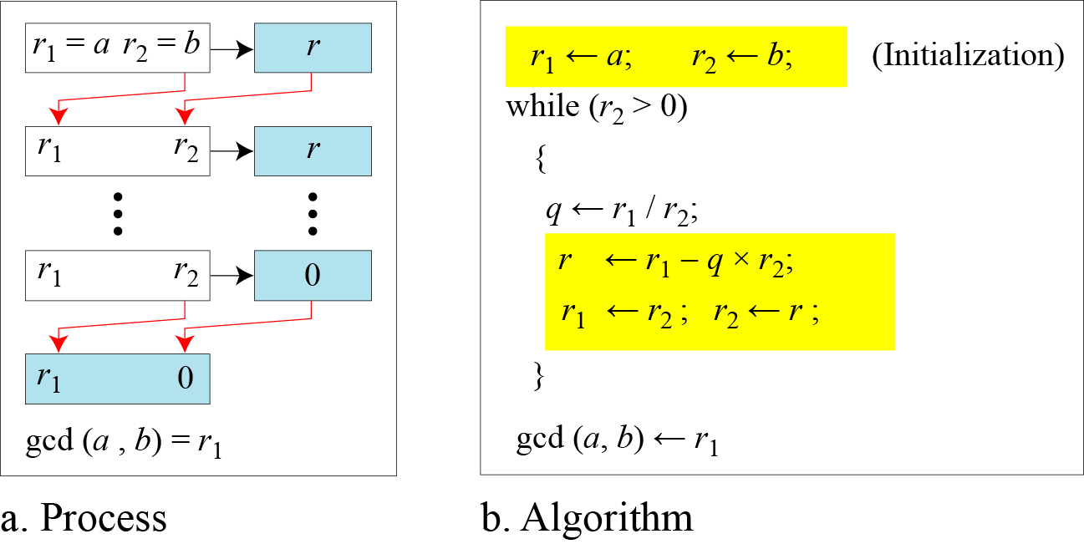
GCD Using Euclidean Algorithm
Figure below shows how we use Fact 1 and Fact 2 to calculate gcd (a, b)
Figure: Euclidean Algorithm
Note:
When gcd (a, b) = 1, we say that a and b are relatively prime or they are coprime.

Slide 19
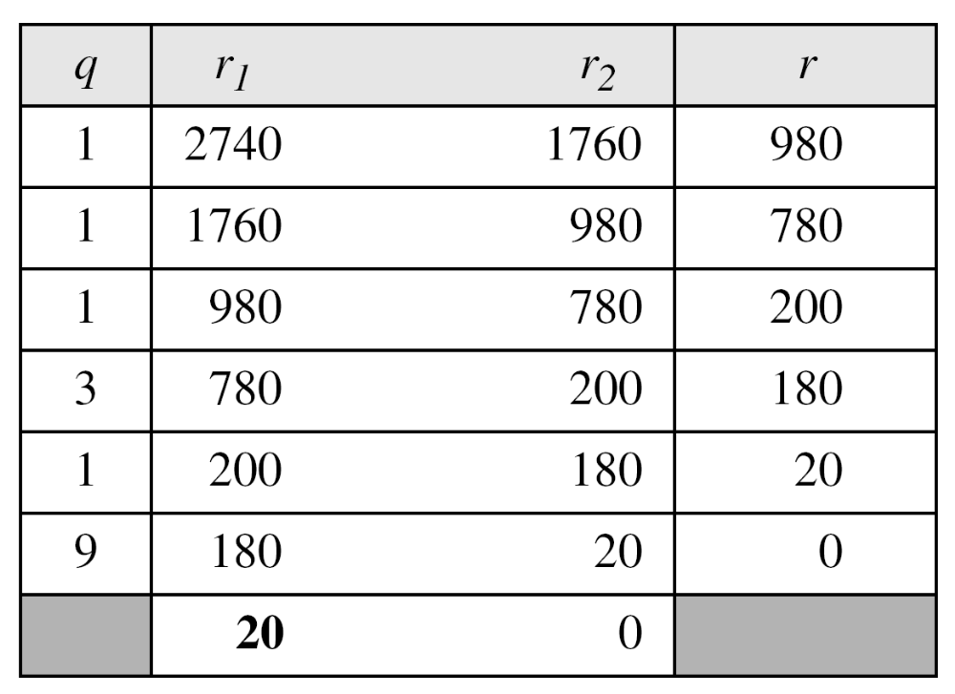
GCD Using Euclidean Algorithm
Example:
Find the greatest common divisor of 2740 and 1760.
Solution:
We have gcd (2740, 1760) = 20.

Slide 20
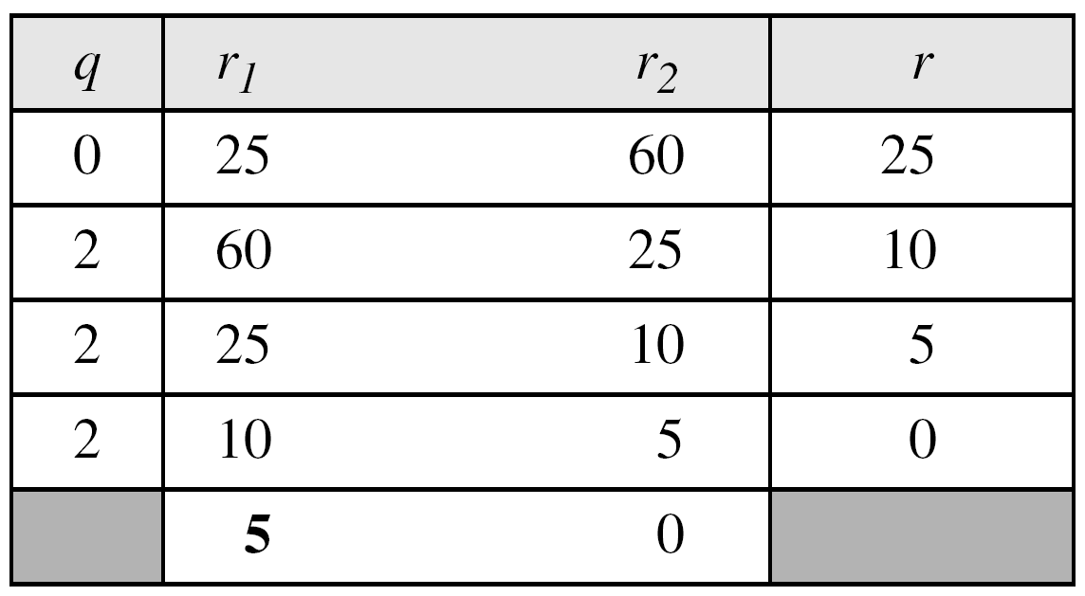
GCD Using Euclidean Algorithm
Example:
Find the greatest common divisor of 25 and 60.
Solution:
We have gcd (25, 60) = 5.
Note:
The above example shows that it does not matter if the first number is smaller than the second number. We immediately get our correct ordering gcd(60, 25).

Slide 21

Extended Euclidean Algorithm
Given two integers a and b, we often need to find other two integers, s and t, such that
The extended Euclidean algorithm can calculate the gcd (a, b) and at the same time calculate the value of s and t.
Using extended Euclidean algorithm, we also can find the solutions to the linear Diophantine equations of two variables, an equation of type ax + by = c.

Slide 22
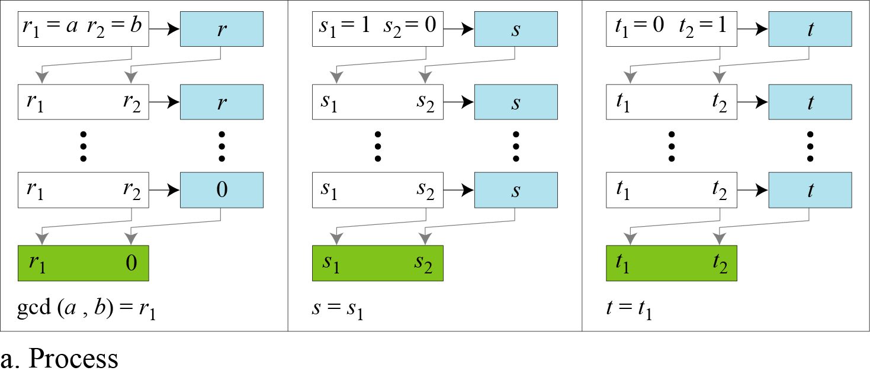
Extended Euclidean Algorithm
Figure: Extended Euclidean algorithm, part a: Process
Note:
Figure shows that the extended Euclidean algorithm uses the same number of steps as the Euclidean algorithm, however, in each step, we use three sets of calculations and exchanges instead of one.
Here, three sets of variables are used: r’s, s’s and t’s.

Slide 23
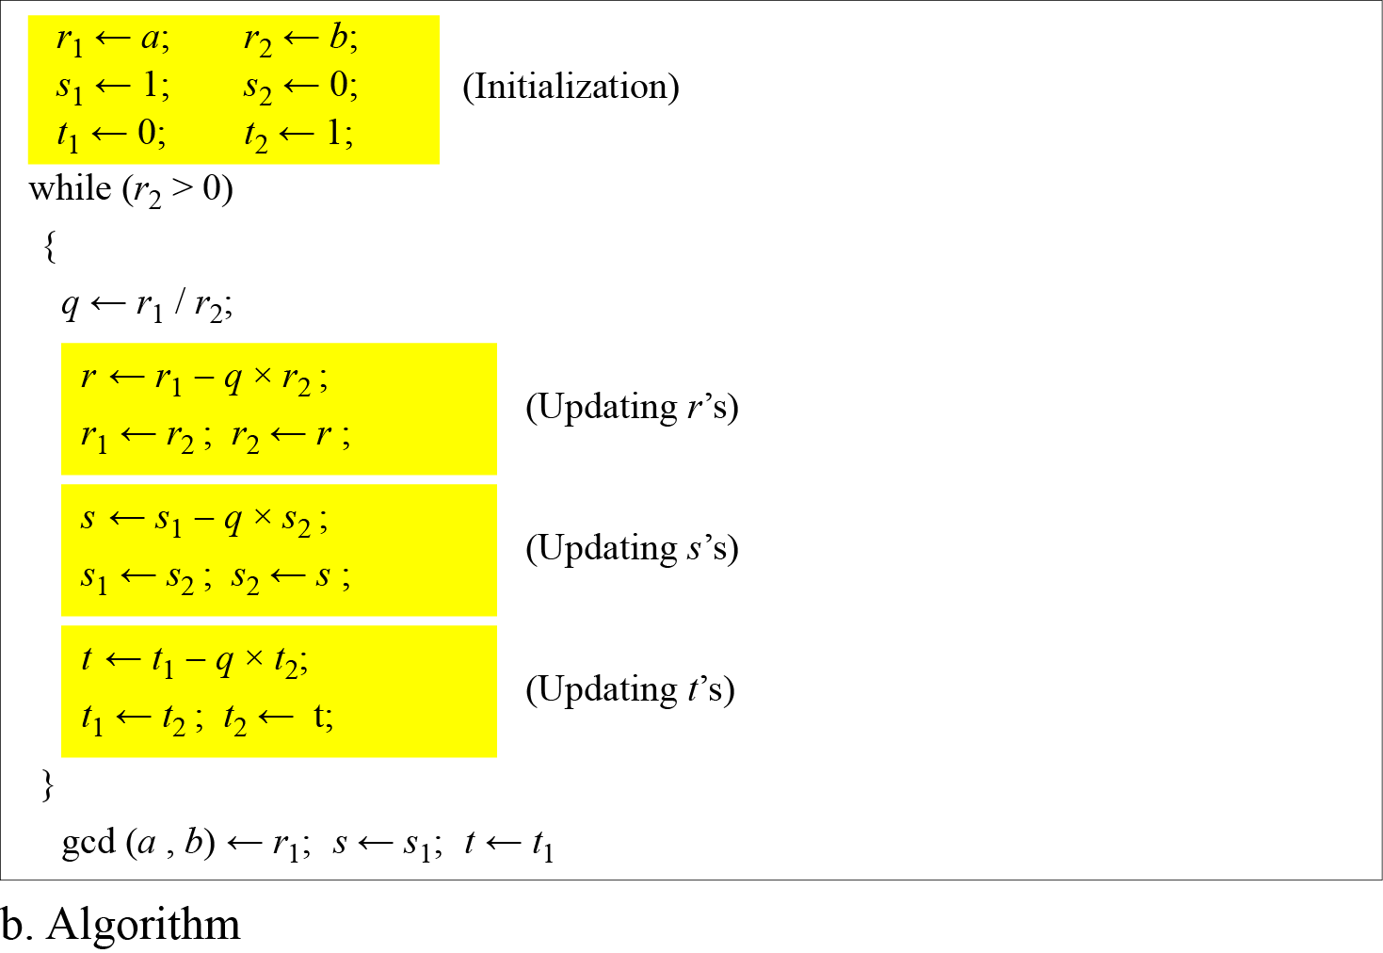
Extended Euclidean Algorithm
Figure: Extended Euclidean algorithm, part b: Algorithm

Slide 24
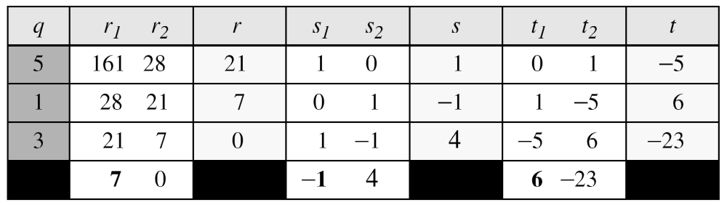
Extended Euclidean Algorithm
Example:
Given a = 161 and b = 28, find gcd (a, b) and the values of s and t such that gcd(a, b) = s × a + t × b.
r = r₁ – q × r₂ s = s₁ – q × s₂ t = t₁ – q × t₂
Solution:
We get gcd (161, 28) = 7, s = −1 and t = 6.
The result can be tested, because (-1) × 161 + 6 × 28 = 7

Slide 25
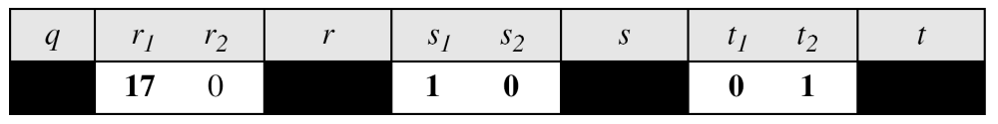
Extended Euclidean Algorithm
Example:
Given a = 17 and b = 0, find gcd (a, b) and the values of s
and t.
Solution:
We get gcd (17, 0) = 17, s = 1, and t = 0.

Slide 26
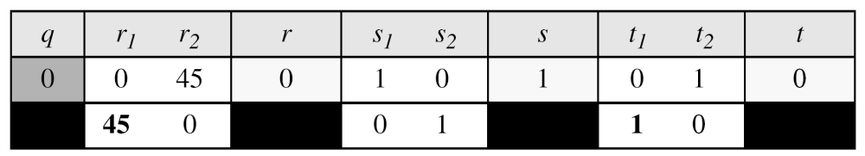
Extended Euclidean Algorithm
Example:
Given a = 0 and b = 45, find gcd (a, b) and the values of s
and t.
Solution:
We get gcd (0, 45) = 45, s = 0, and t = 1.

Slide 27
Linear Diophantine Equation
A linear Diophantine equation of two variables is like: ax + by = c.
Using extended Euclidean algorithm, we can find the solutions to the linear Diophantine equations, that is, we can find the integer values for x and y that satisfy the equation.
Linear Diophantine equation has either no solution or has an infinite number of solutions:
Let d = gcd(a, b)
If dłc, then the equation has no solution.
If d|c, then the equation has an infinite number of solutions. Among the solutions, one is called particular solution, and the rest is called general solutions.

Slide 28
Linear Diophantine Equation
Particular solution:
Let ax + by = c is a linear Diophantine equation.
Also let, d = gcd(a,b).
If d|c, then a particular solution of the equation can be found using the following steps:
Reduce the equation to a₁x + b₁y = c₁ by dividing both sides of the equation by d.
Solve for s and t in the relation a₁s + b₁t = 1 using extended Euclidean algorithm.
3. The particular solution can be found:
x₀ = (c/d)s and y₀ = (c/d)t

Slide 29
Linear Diophantine Equation
General solution:
After finding the particular solution, the general solutions of linear Diophantine equation can be found:
x = x₀ + k (b/d) and y = y₀ − k(a/d)
where k is an integer

Slide 30
Linear Diophantine Equation
Example:
Using extended Euclidean algorithm, find the particular and general solutions to the following linear Diophantine equation:
21x + 14y = 35.
Solution:
Here, a = 21, b = 14 and c = 35.
d = gcd(a, b) = gcd(21,14) = 7. Since d | c or 7 | 35, the equation has an infinite number of solutions.
Reduce the equation by dividing both sides by 7 to find the equation: 3x + 2y = 5. Here a₁=3, b₁=2 and c₁=5.
Using extended Euclidean algorithm, we find the value of s and t such that 3s + 2t = 1. We have s = 1 and t = -1.
Particular solution:
x₀ = (c/d)s and y₀ = (c/d)t
X₀ = (35/7) × 1 = 5 × 1 = 5 and y₀ = (35/7) × (-1) = -5
General solution:
x = x₀ + k (b/d) and y = y₀ − k(a/d) where k is an integer
X = 5 + k (14/7) = 5 + k × 2 y= -5 – k (21/7) = -5 – k × 3
Therefore, the solutions to the above equation are (5, -5), (7, 8), (9, -11) …..

Slide 31
Linear Diophantine Equation
Application:
A very interesting application of linear Diophantine equation in real life is when we want to find different combinations of objects having different values.
For example, imagine we want to cash a $100 check and get some $20 and some $5 bills. We have many choices which can be found by solving the corresponding Diophantine equation 20x + 5y = 100.
Since d = gcd (20, 5) = 5 and 5 | 100, the equation has an infinite number of solutions, but only a few of them are acceptable in this case (only the answers in which both x and y are non-negative integers, because of cash value which can not be negative).
The general solutions with x and y nonnegative are
(0, 20), (1, 16), (2, 12), (3, 8), (4, 4), (5, 0).

Slide 32
Modular Arithmetic
Given any positive integer n and any nonnegative integer a, if we divide a by n, we get an integer quotient q and an integer remainder r such that a = q × n + r.
This division relation has two inputs (a and n) and two outputs (q and r).
In modular arithmetic, we are interested in only one of the outputs, the remainder r. In other words, we want to know what is the value of r when we divide a by n. This implies that, using modular arithmetic, we can change the division relation into a binary operator (called modulo operator) with two inputs a and n and one output r.
Several important cryptosystems make use of modular arithmetic.

Slide 33
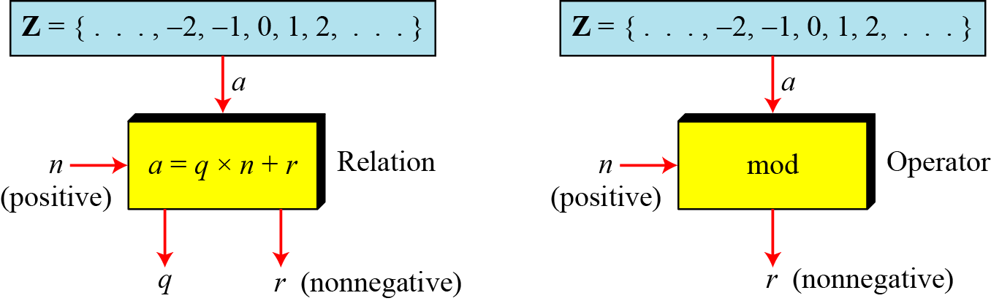
Modular Arithmetic
The modulo operator is shown as mod. The second input (n) is called the modulus. The output r is called the residue.
Figure below shows the division relation compared with the modulo operator.
Figure: Division relation Vs. modulo operator
In the figure we see that the modulo operator (mod) takes an integer (a) from the set of integers (Z) and a positive modulus (n). The operator creates a non-negative residue (r) where 0 <= r <= n-1. We can say that:
a mod n = r

Slide 34
Modular Arithmetic
Calculation of a mod n:
There are three cases:
Case-1: When both of a and n is positive integer where a<n:
In this case, we add as many multiples of n with a as necessary to get a greater than n. Then divide a by n to get the remainder r. The result will be in the range 0 to n-1.
For example, 2 mod 7 = 9 mod 7 = 2.
Case-2: When both of a and n is positive integer where a>=n:
In this case, just divide a by n to get the remainder r. The result will be in the range 0 to n-1.
For example, 9 mod 7 = 2.
Case-3: When a is negative and n is positive integer:
In this case, we add as many multiples of n with a as necessary to get a positive and greater than n. Then divide a by n to get the remainder r. The result will be in the range 0 to n-1. The process is known as modulo reduction.
For example, -12 mod 7 = -5 mod 7 = 2 mod 7 = 9 mod 7

Slide 35
Modular Arithmetic
Example:
Find the result of the following operations:
a. 27 mod 5 b. 36 mod 12
c. −18 mod 14 d. −7 mod 10
Solution:
Dividing 27 by 5 results in r = 2. Therefore 27 mod 5 = 2
Dividing 36 by 12 results in r = 0. Therefore 36 mod 12 = 0
c. Dividing −18 by 14 results in r = −4. After adding the modulus (14) with the result to make it non-negative, we have r = -4 + 14 = 10. Therefore -18 mod 14 = 10
d. Dividing −7 by 10 results in r = −7. After adding the modulus (10) with the result to make it non-negative, we have r = -7 + 10 = 3. Therefore –7 mod 10 = 3

Slide 36
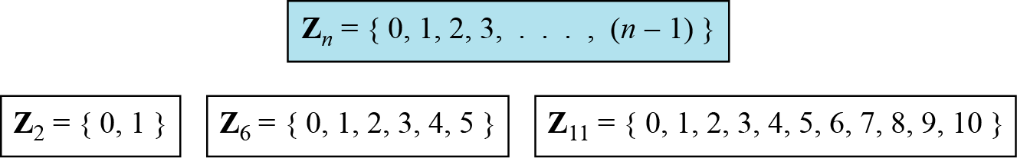
Z_{n}: Set of Residues
The result of a mod n is always an integer between 0 and n-1.
Therefore, the modulo operation creates a set, which in modular arithmetic is referred to as the set of least residues modulo n, or Z_{n}.
Figure below shows the set of residues Z_{n} and three instances of the set of residues Z₂, Z₆, Z₁₁.
Figure: Some Z_{n} sets

Slide 37
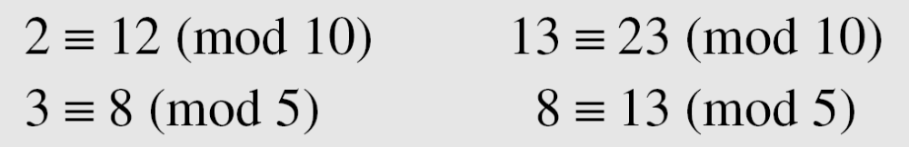
Congruence
The result of 2 mod 10 = 2, 12 mod 10 = 2, 22 mod 10 = 2, 32 mod 10 = 2 and so on.
In modular arithmetic, integers like 2, 12, 22 and 32 are called congruent mod 10.
To show that two integers are congruent, we use the congruence operator ( ≡ ). For example, we write:

Slide 38
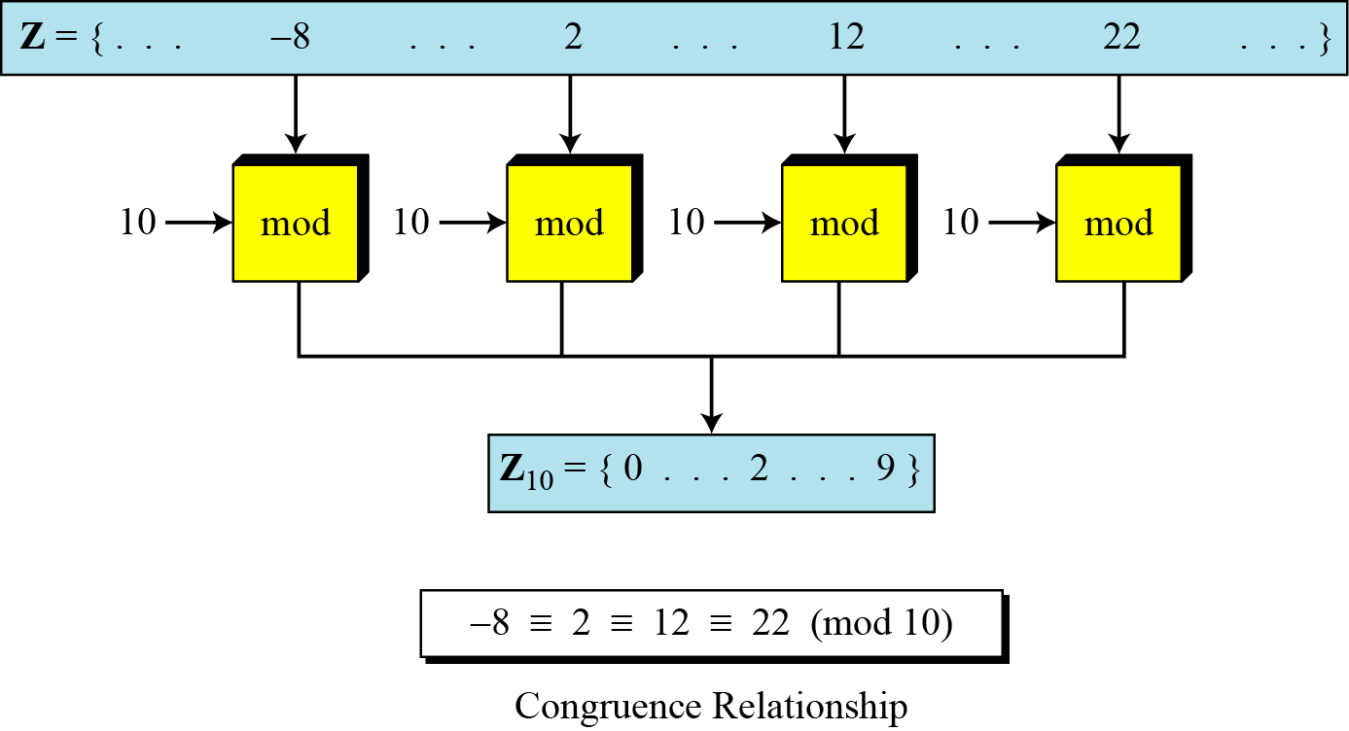
Congruence
Figure below shows the idea of congruence.
Figure 2.11 Concept of congruence

Slide 39
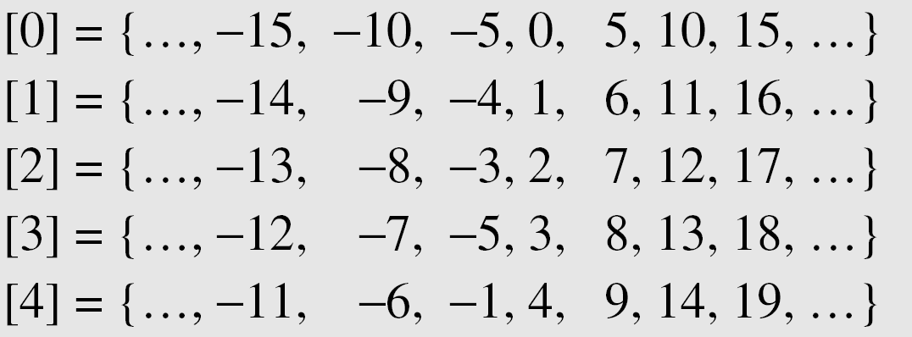
Modular Arithmetic
Residue Sets or Classes:
A residue class [a] or [a]_{n} is the set of integers congruent modulo n. That is, a residue class is the set of all integers such that x = a (mod n). For example, if n = 5, we have five sets of residue classes [0], [1], [2], [3] and [4] as shown below:
Note:
All the integers in the residue class [0] are reduced to 0 when we apply the modulo 5 operation on them.
Similarly, all the integers in the residue class [1] are reduced to 1 when we apply the modulo 5 operation on them, and so on.
In each residue set or class, there is one element called the least residue. For example, in set [0], [1], [2], [3] and [4], this element (least residue) is 1, 2, 3, and 4 respectively. The set of all of these least residues is written as Z₅ = {0, 1, 2, 3, 4}. In other words, the set Z_{n} is the set of all least residue modulo n.

Slide 40
Modular Arithmetic: Inverse
In cryptography, we often need to find the inverse of a number relative to an operation e.g., encryption/decryption.
For example, if the sender uses an integer as the encryption key, the receiver uses the inverse of that integer as the decryption key.
We are normally looking for two kinds of inverse:
Additive Inverse
  If the operation is addition, we are normally looking for additive inverse.
  The set of additive inverse is expressed as Z_{n}
Multiplicative Inverse
  If the operation is multiplication, we are normally looking for multiplicative inverse.
  The set of multiplicative inverse is expressed as Z_{n*}

Slide 41

Modular Arithmetic: Additive Inverse
In Z_{n}, two numbers a and b are additive inverses of each other if
In modular arithmetic, each integer has an additive inverse.
The sum of an integer and its additive inverse is congruent to 0 modulo n.
Example:
Find all additive inverse pairs in Z₁₀.
Solution:
The six pairs of additive inverses are:
(0, 0), (1, 9), (2, 8), (3, 7), (4, 6), and (5, 5).

Slide 42

Modular Arithmetic: Multiplicative Inverse
In Z_{n}, two numbers a and b are the multiplicative inverse of each other if
In modular arithmetic, an integer may or may not have a multiplicative inverse.
When it does, the product of the integer and its multiplicative inverse is congruent to 1 modulo n.
Example:
Find the multiplicative inverse of 8 in Z₁₀.
Solution:
There is no multiplicative inverse of 8 in Z₁₀ because gcd (10, 8) = 2 ≠ 1.
In other words, we cannot find any number between 0 and 9 such that when multiplied by 8, the result is congruent to 1.

Slide 43
Modular Arithmetic: Multiplicative Inverse
Example:
Find all multiplicative inverses in Z₁₀.
Solution:
There are only three pairs: (1, 1), (3, 7) and (9, 9). The numbers 0, 2, 4, 5, 6, and 8 do not have a multiplicative inverse.
Example:
Find all multiplicative inverse pairs in Z₁₁.
Solution:
We have seven pairs: (1, 1), (2, 6), (3, 4), (5, 9), (7, 8), (9, 5), and (10, 10).

Slide 44
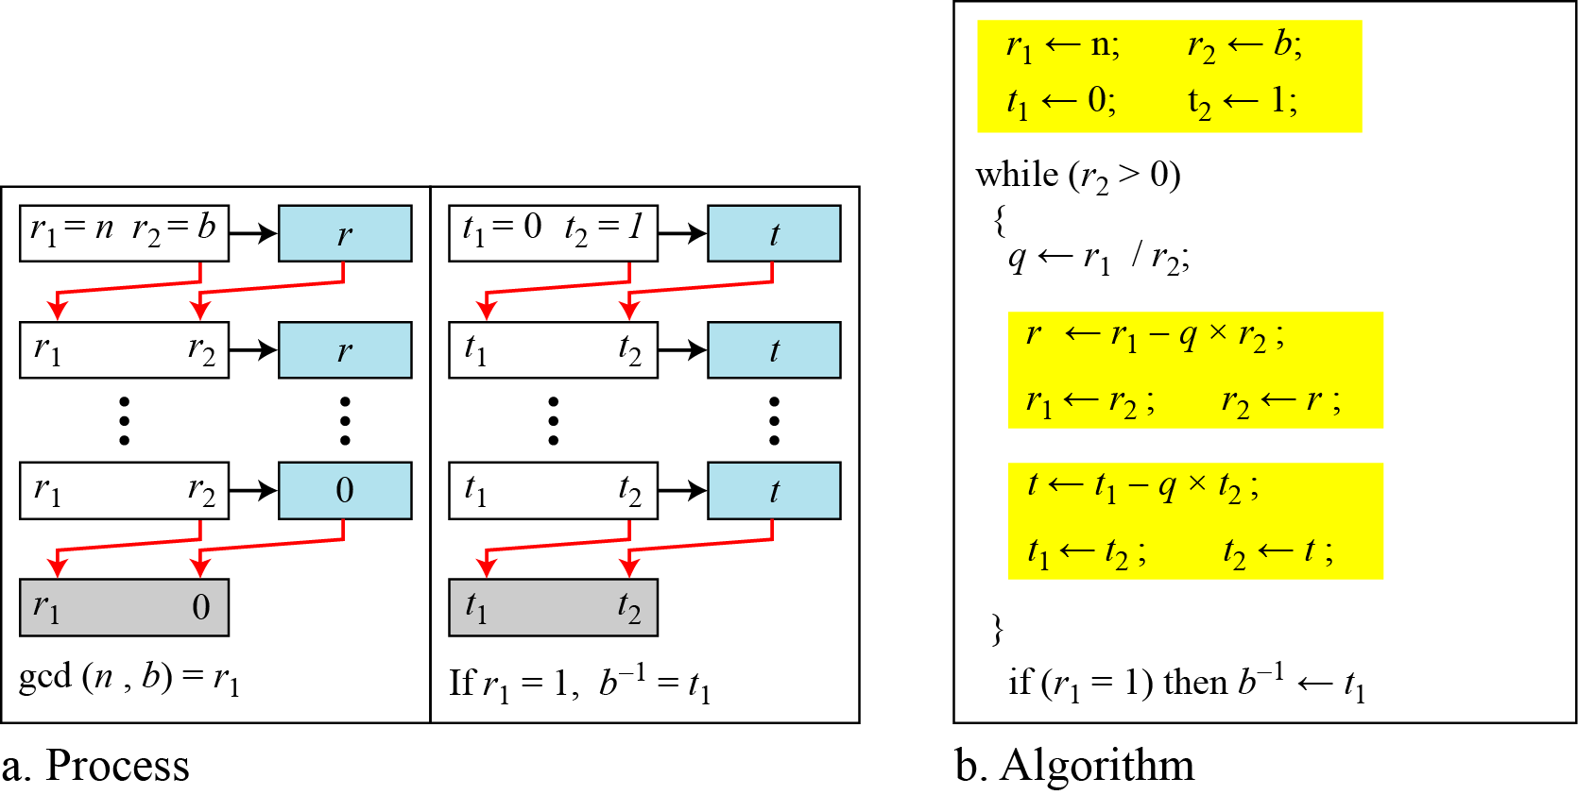
Modular Arithmetic: Multiplicative Inverse
Multiplicative Inverse Using Extended Euclidean Algorithm:
The extended Euclidean algorithm finds the multiplicative inverses of b in Z_{n} when n and b are given and gcd (n, b) = 1.
The multiplicative inverse of b is the value of t after being mapped to Z_{n}.
Figure: To find multiplicative inverse using extended Euclidean algorithm

Slide 45
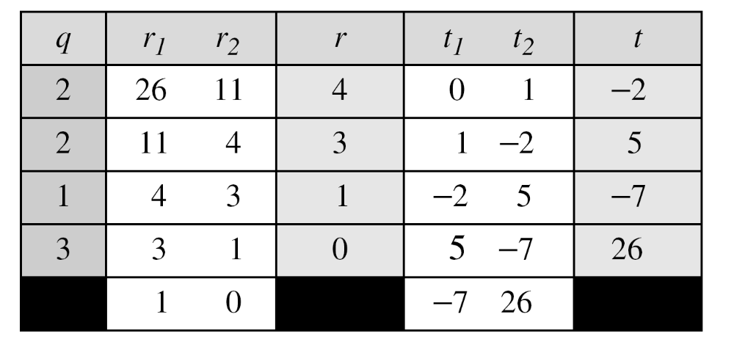
Modular Arithmetic: Multiplicative Inverse
Example-1:
Find the multiplicative inverse of 11 in Z₂₆ using extended Euclidean algorithm.
Solution:
The gcd (26, 11) is 1; the inverse of 11 is -7 or 19.

Slide 46
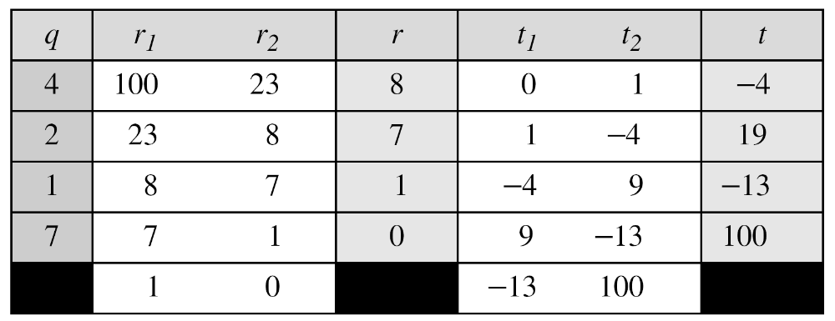
Modular Arithmetic: Multiplicative Inverse
Example-2:
Find the multiplicative inverse of 23 in Z₁₀₀ using extended Euclidean algorithm
Solution:
The gcd (100, 23) is 1; the inverse of 23 is -13 or 87.

Slide 47
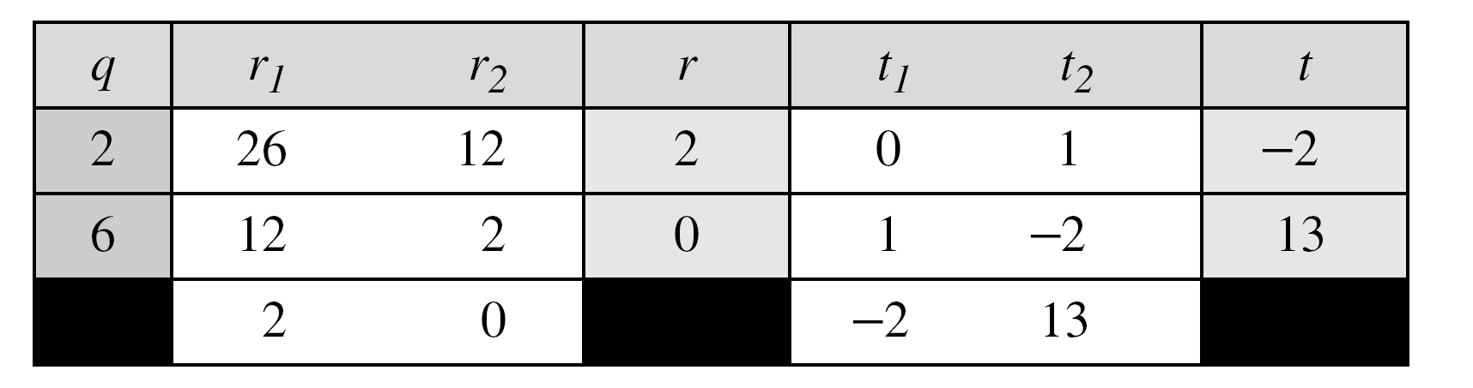
Modular Arithmetic: Multiplicative Inverse
Example-3:
Find the inverse of 12 in Z₂₆ using extended Euclidean algorithm.
Solution:
The gcd (26, 12) is 2; the inverse does not exist.

Slide 48
Modular Arithmetic: Multiplicative Inverse
Multiplicative Inverse Using Fermat’s Little Theorem:
If the modulus is a prime, then multiplicative inverse of an integer can be found quickly without using the Extended Euclidean’s algorithm:
If p is a prime and a is an integer such that p does not divide a (p†a), then
a⁻¹ mod p = a^{p-2} mod p
Example:
Find the multiplicative inverse of 8 in Z₁₇ using Fermat’s Little Theorem.
Solution:
Since, the modulus 17 is a prime, so according to Fermat’s Little theorem,
8⁻¹ mod 17 = 8¹⁷⁻² mod 17 = 8¹⁵ mod 17 = 15

Slide 49
Set of Additive and Multiplicative Inverse
Set of Additive Inverse Z_{n} :
Z_{n} is a set that contains all integers from 0 to n-1.
In Z_{n} , each integer has an additive inverse. Therefore Z_{n} can also be used as the set of additive inverse.
Each member of Z_{n} has an additive inverse.
Set of Multiplicative Inverse Z_{n*} :
In Z_{n}, an integer may or may not have a multiplicative inverse. Only some members of Z_{n} have a multiplicative inverse.
Therefore, for multiplication operation, we need another set Z_{n}* which is a subset of Z_{n} that includes only those integers from Z_{n} that have a unique multiplicative inverse.
Note:
  Each member of Z_{n} has an additive inverse, but only some members of Z_{n} have a multiplicative inverse.
  On the other hand, Each member of Z_{n}* has a multiplicative inverse, but only some members of Z_{n}* have an additive inverse.

Slide 50
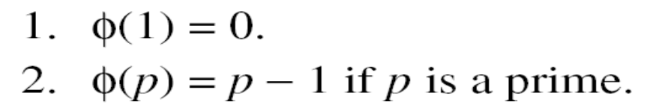
Set of Additive and Multiplicative Inverse
Finding the number of elements in Z_{n} :
Z_{n} is a set that contains all integers from 0 to n-1.
Finding the number of elements in Z_{n*} :
We can determine the number of elements in the set Zn* using Euler’s Phi-Function (sometimes called the Euler’s Totient function), Φ(n) that finds the number of integers that are both smaller than n and relatively prime to n.
The following rules helps to find the value of Φ(n):

Slide 51
Set of Additive and Multiplicative Inverse
Example-1:
Find the number of elements in Z₁₃* using Euler’s Phi-Function.
Solution:
Since 13 is a prime, so according to the second rule,
Φ(13)=(13-1)=12
Example-2:
Find the number of elements in Z₁₀* using Euler’s Phi-Function.
Solution:
Since 10 is not a prime, so according to the third rule,
Φ(10)= Φ(5x2)= Φ(2) x Φ(5)=(2-1) x (5-1)= 1 x 4 =4
Example-3:
Find the number of elements in Z₄₉* using Euler’s Phi-Function.
Solution:
Since 49 is not a prime and it can not be factored as the product of two relatively primes, so according to the fourth rule,
Φ(49)= Φ(7²)= 7² – 7²⁻¹= 49 – 7 = 42

Slide 52
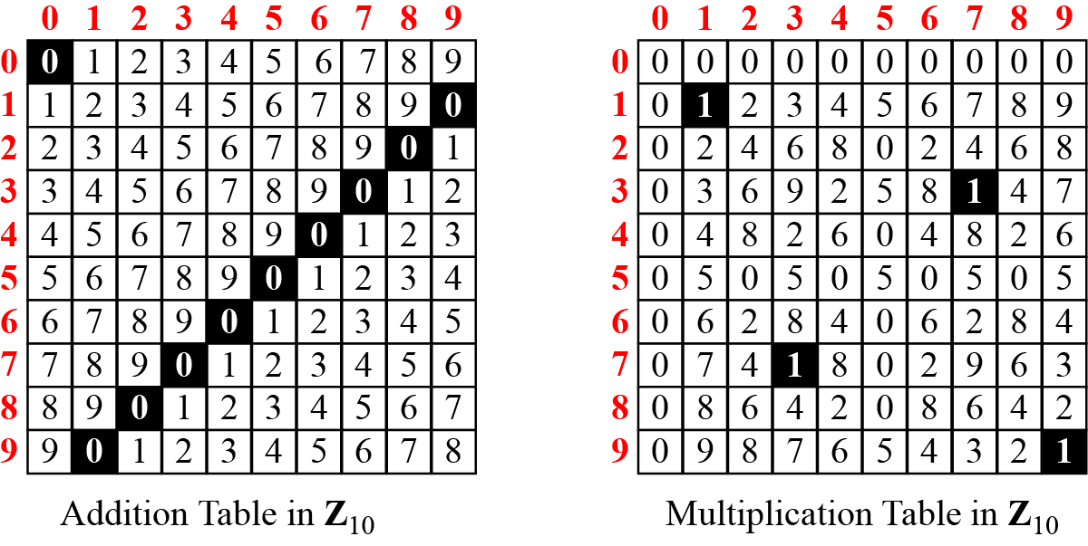
Additive and Multiplicative Inverse Using Multiplication Tables
  Z_{n} and Z_{n}* can be made from addition and multiplication tables respectively.
  We need to use Z_{n} when additive inverses are needed; we need to use Z_{n}* when multiplicative inverses are needed.
Figure: Addition and multiplication table for Z₁₀

Slide 53
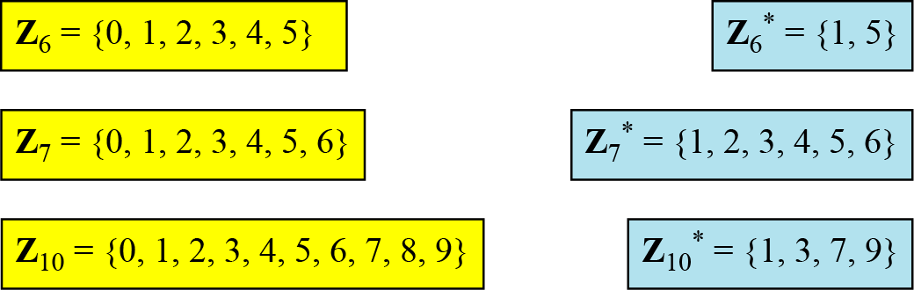
Set of Additive and Multiplicative Inverse
Some Instances of Z_{n} and Z_{n*}
Figure: Some Z_{n} and Z_{n}* sets

Slide 54
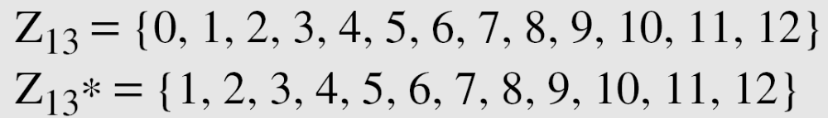
Set of Additive and Multiplicative Inverse
Two More Sets: Z_{p} and Z_{p*} :
Cryptography often uses two more sets: Z_{p} and Z_{p}*. The modulus in these two sets is a prime number.
The set Z_{p} is the same as Z_{n} except that n is a prime.
Z_{p} contains all integers from 0 to p-1.
Each member in Z_{p} has an additive inverse; each member except 0 has a multiplicative inverse.
The set Z_{p*} is the same as Z_{n*} except that n is a prime.
Z_{p*} contains all integers from 1 to p-1.
Each member in Z_{p*} has an additive and a multiplicative inverse.
Z_{p}* is a very good candidate when we need a set that supports both additive and multiplicative inverse.
Figure: The set Z_{p} and Z_{p*} when p=13

Slide 55
Matrices
In cryptography we need to handle matrices. Although this topic belongs to a special branch of algebra called linear algebra, the following brief review of matrices is necessary preparation for the study of cryptography.
Topics discussed in this section:
Definitions
Operations and Relations
Determinants
Residue Matrices

Slide 56
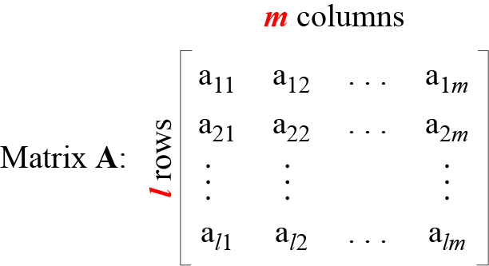
Matrices
A matrix is a rectangular array of l×m elements, in which l is the number of rows and m is the number of columns.
It is normally denoted with a boldface uppercase letter such as A.
The element a_{ij} is located in the ith row and jth column.
Figure: A matrix of size l × m

Slide 57
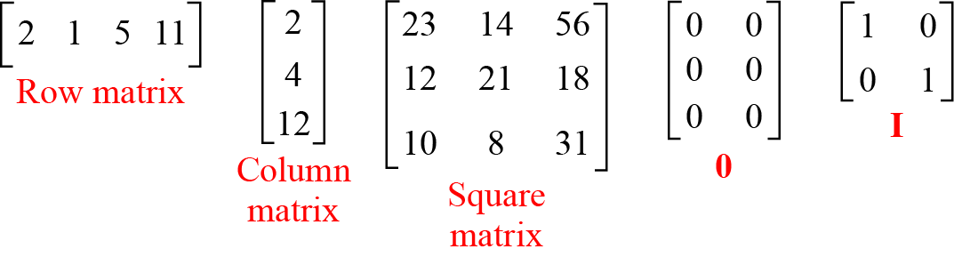
Matrices
Example of Matrices:
Row matrix:
If a matrix has only one row (l), then it is called a row matrix.
Column matrix:
If a matrix has only one column (m), then it is called a column matrix.

Slide 58
Matrices
Example of Matrices:
Square matrix:
If a matrix has same number of rows and columns (l = m), then it is called a square matrix. In a square matrix, the elements a₁₁, a₂₂, ….. ,a_{mm} make the main diagonal.
Additive Identity matrix:
It is a kind of matrix with all rows and columns set to 0’s. It is denoted as O.
Identity matrix:
It is a kind of square matrix with 1’s on the main diagonal and 0’s elsewhere. It is denoted as I.

Slide 59
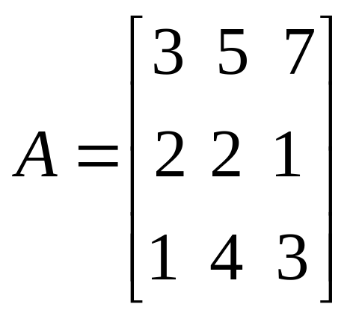
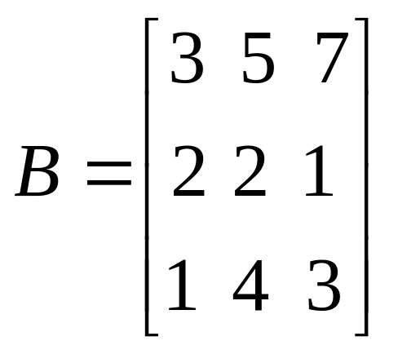
Matrices
Operations and Relations in Matrices:
In linear algebra, one relation (equality) and four operations (addition, subtraction, multiplication and scalar multiplication) are defined for matrices.
Equality:
Two matrices are equal if they have the same number of rows and columns and the corresponding elements are equal. In other words, A = B if we have aij = B_{ij} for all i’s and j’s.

Slide 60
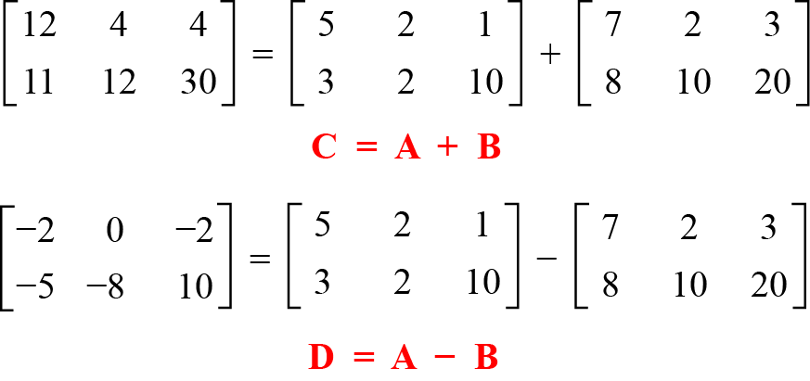
Matrices
Addition and Subtraction:
Two matrices can be added if they have the same number of rows and columns. The resulting matrix has also the same number of rows and columns, e.g. A + B = C.
Example:
Figure: Addition and subtraction of matrices

Slide 61
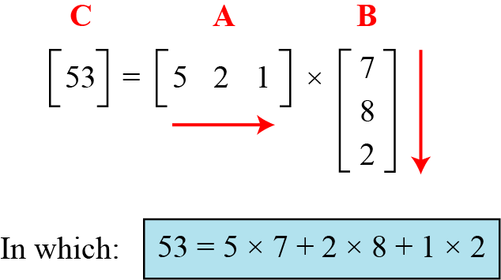
Matrices
Multiplication:
Two matrices can be multiplied if the number of columns of the first matrix is the same as the number of rows of the second matrix. If A is an l×m matrix and B is an m×p matrix, then their product is a matrix C of size l×p.
Example:
Figure 2.21 shows the product of a row matrix (1 × 3) by a column matrix (3 × 1). The result is a matrix of size 1 × 1.
Figure: Multiplication of a row matrix by a column matrix

Slide 62
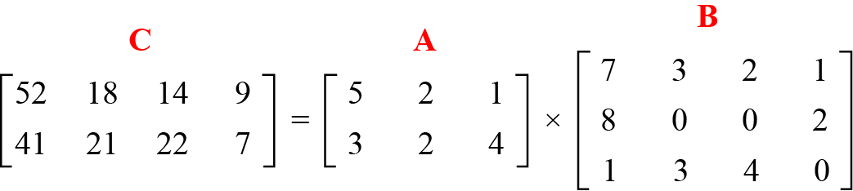
Matrices
Example:
Figure 2.22 shows the product of a 2 × 3 matrix by a
3 × 4 matrix. The result is a 2 × 4 matrix.
Figure: Multiplication of a 2 × 3 matrix by a 3 × 4 matrix

Slide 63
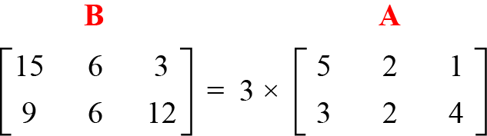
Matrices
Scalar Multiplication:
We can multiply a matrix by a number (called a scalar). If A is an l×m matrix and x is a scalar, then C = xA is a matrix of size l×m.
Example:
Figure below shows an example of scalar multiplication.
Figure: Scalar multiplication

Slide 64
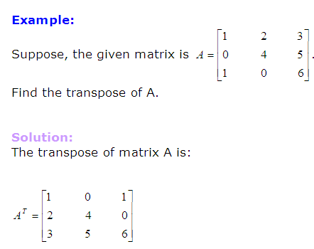
Matrices
Transpose of a Matrix:
A matrix which is formed by turning all the rows of a given matrix into columns and vice-versa is called the transpose of the original matrix. The transpose of matrix A is written A^{T}.

Slide 65
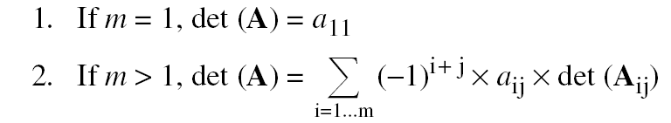
Matrices
Determinant
The determinant of a square matrix A of size m × m denoted as det (A) is a scalar calculated recursively as shown below:
The determinant is defined only for a square matrix.

Slide 66
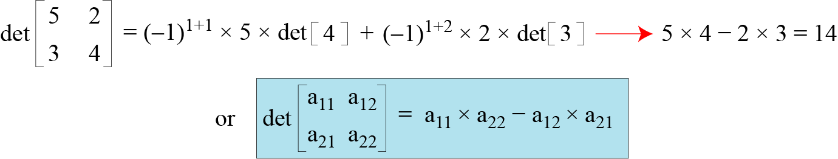
Matrices
Example:
Figure below shows how we can calculate the determinant of a 2 × 2 matrix based on the determinant of a 1 × 1 matrix.
Figure: Calculating the determinant of a 2 × 2 matrix

Slide 67
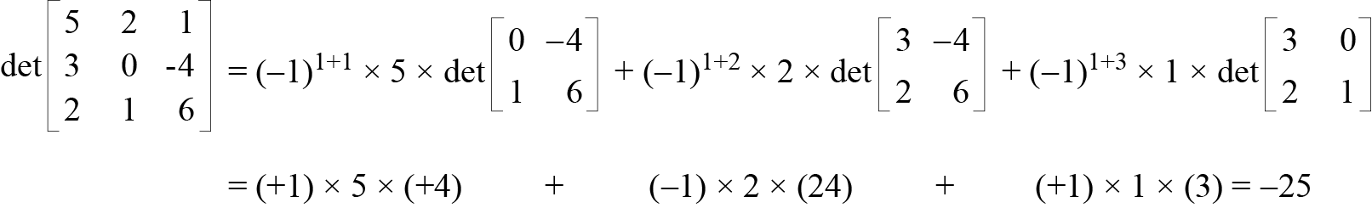
Matrices
Example:
Figure below shows the calculation of the determinant of a 3 × 3 matrix.
Figure: Calculating the determinant of a 3 × 3 matrix

Slide 68
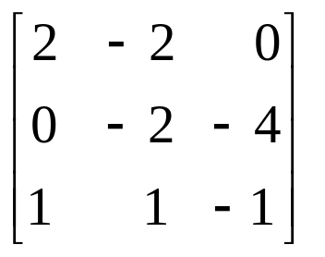
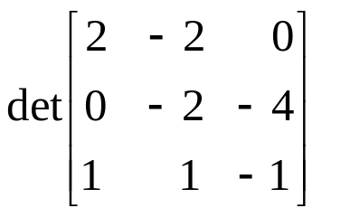



Matrices
More Example
Calculate the determinant of the following matrix.

Slide 69
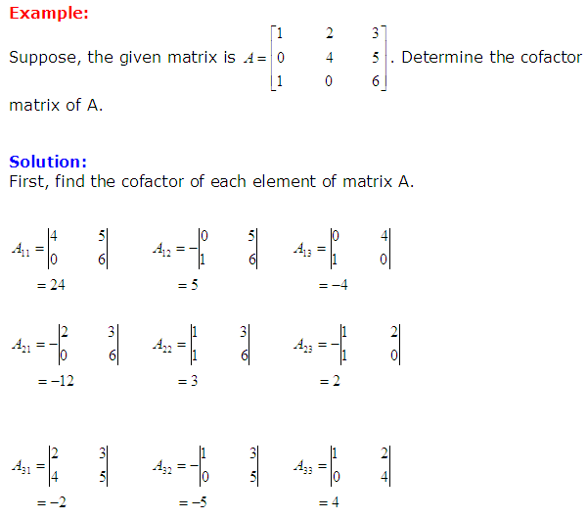
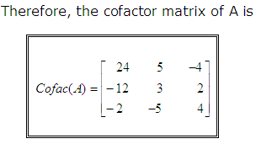
Matrices
Cofactor Matrix of a Given Matrix

Slide 70
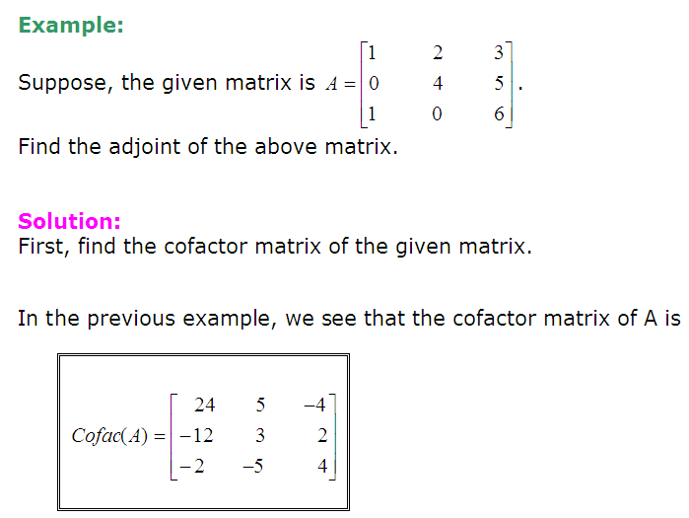
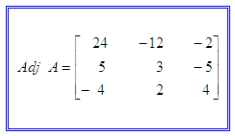
Matrices
Adjoint of a Given Matrix
The matrix formed by taking the transpose of the cofactor matrix of a given original matrix is called the adjoint of the given matrix. The adjoint of matrix A is often written adj A.
Finally the adjoint of A is the transpose of the cofactor matrix:

Slide 71
Matrices
Inverse of Matrix
For an n×n square matrix A, the inverse of A (written as A⁻¹) is another n×n square matrix such that when A is multiplied by A⁻¹ the result is an n×n identity matrix I. Not all n×n matrices are invertible. Non-square matrices do not have inverses.
AA⁻¹ = A⁻¹A = I
  A matrix which is not invertible is sometimes called a singular matrix.
  An invertible matrix is called a nonsingular matrix.

Slide 72
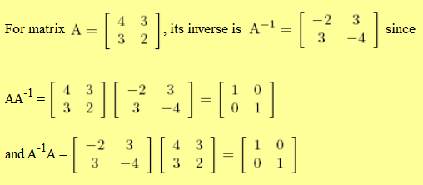
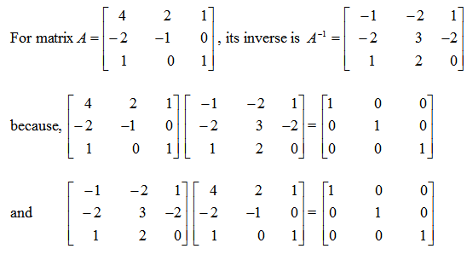
Matrices
Examples:

Slide 73


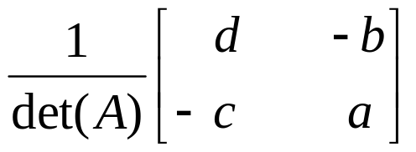
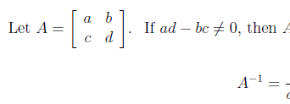

Matrices
Determining the Inverse of Matrix
When A is a 2×2 Matrix:
Example-1:

Slide 74
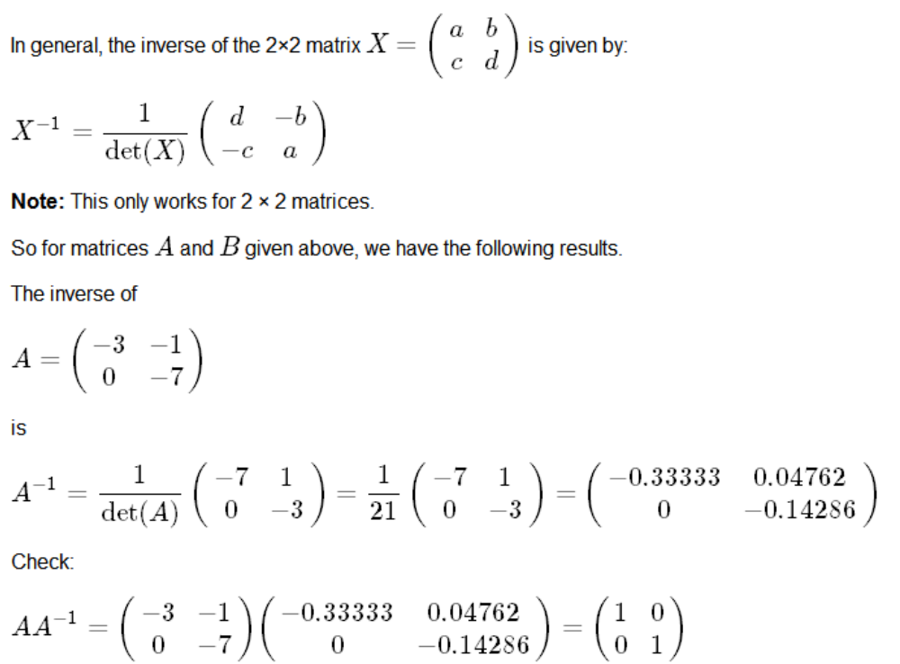
Matrices
When A is a 2×2 Matrix:
Example-2:

Slide 75

Matrices
When A is an m×m Matrix:
To find the inverse of an m×m matrix, follow the steps given below:
1. Find the adjoint of the given matrix.
2. Find the determinant of the given matrix.
3. Now, determine the inverse using the above formula.

Slide 76
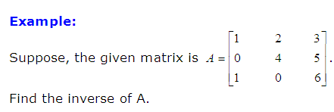


Matrices
Solution:
The adjoint of A is :
The determinant of A is :
The inverse of A is :

Slide 77
Matrices
Additive & Multiplicative Inverse of Matrix
Matrices have both additive and multiplicative inverses.
Additive Inverse of a Matrix:
The additive inverse of a matrix A is another matrix B such that A + B = 0. In other words, we have a_{ij} = - b_{ij} for all values of i and j. Normally the additive inverse of A is denoted by –A.

Slide 78
Matrices
Multiplicative Inverse of a Matrix:
The multiplicative inverse of a square matrix A is another square matrix B such that A × B = B × A = I. Normally the multiplicative inverse of A is denoted by A⁻¹.
The multiplicative inverse exists only if the det(A) has a multiplicative inverse in the corresponding set.
Multiplicative inverses are only defined for square matrices.

Slide 79

Matrices
Residue Matrices
Cryptography uses residue matrices: matrices where all elements are in Z_{n}. A residue matrix has a multiplicative inverse if gcd (det(A), n) = 1.
Example:
Figure: A residue matrix and its multiplicative inverse

Slide 80
Linear Congruence
Cryptography often involves solving an equation or a set of equations of one or more variables with coefficient in Z_{n}. This section shows how to solve equations when the power of each variable is 1 (linear equation).
Topics discussed in this section:
Single-Variable Linear Equations
Set of Linear Equations

Slide 81



Linear Congruence
Single-Variable Linear Equations
Equations of the form ax ≡ b (mod n ) is a single variable linear equation. This type of equation might have no solution or a limited number of solutions.

Slide 82
Linear Congruence
If d|b, we use the following strategy to find the solution to a single-variable linear equation:
Reduce the equation by dividing both sides of the equation (including the modulus) by d where d = gcd (a, n).
Multiply both sides of the reduced equation by the multiplicative inverse of a to find the particular solution x₀.
The general solutions are x = x₀ + k(n/d) for k = 0, 1, …..(d-1).

Slide 83
Linear Congruence
Example:
Solve the equation 10 x ≡ 2(mod 15).
Solution
First we find the gcd (10 and 15) = 5. Since 5 does not divide 2, we have no solution.

Slide 84

Linear Congruence
Example:
Solve the equation 14 x ≡ 12 (mod 18).
Solution
First we find the gcd (14 and 18) = 2. Since 2 divides 12, we have exactly two solutions.
Here 4 is the multiplicative inverse of 7 in Z₉. That is, if we multiply 4 and 7 and then divide the result by 9, we get 1 as the remainder.
Both solutions 6 and 15 satisfy the congruence relation, because (14×6) mod 18 = 12 and also (14×15) mod 18 = 12.

Slide 85
Linear Congruence
Example:
Solve the equation 3x + 4 ≡ 6 (mod 13).
Solution
First we change the equation to the form ax ≡ b (mod n).
We add −4 (the additive inverse of 4) to both sides, which give
3x ≡ 2 (mod 13).
Because gcd (3, 13) = 1, the equation has only one solution, which is:
x₀ = (2 × 3⁻¹) mod 13 = (2×9) mod 13 = 18 mod 13 = 5.
Here 9 is the multiplicative inverse of 3 in Z₁₃. We can see that the answer satisfies the original equation:
3 × 5 + 4 ≡ 6 (mod 13).

Slide 86

Linear Congruence
Set of Multiple-Variable Linear Equations
We can also solve a set of linear equations with the same modulus if the matrix formed from the coefficients of the variables is invertible.
To solve, we make three matrices:
  The first is the square matrix made from the coefficients of the variables.
  The second is a column matrix made from the variables.
  The third is a column matrix made from the values at the right-hand side of the congruence operator.
Figure : Set of linear equations
3rd matrix
Multiplicative inverse of the first matrix
1st matrix
2nd matrix

Slide 87





Linear Congruence
Example:
Solve the set of following three equations:
Solution
At first, we form a matrix from the coefficients of variables of the equations. The matrix is invertible.
Now, we determine the multiplicative inverse of the matrix.

Slide 88
Linear Congruence
The result is
x ≡ 15 (mod 16)
y ≡ 4 (mod 16)
z ≡ 14 (mod 16)
We can check the answer by inserting these values into the equations.

